Slide 1
Tour of Postgres for Oracle Devotees
Notes:
Welcome! Before we begin I’d like to get a feel for where you are all at with regard to Postgres?
How many of you are currently using or administering PG?
How many of you have PG at work, and might have to use it, so you’re here to learn about it?
The rest I’m assuming would just like to know about PG?
I new close to nothing about PG five years ago. Other than a 2 year stint on DB2 at the start of my career, I had been an Oracle devotee since 1995.
I’ve now used PG from v9 to v15 both on-prem and in-cloud, Enterprise DB, vanilla open source, AWS RDS and Aurora, and Azure Single and Flexible server. I’m no expert, but I’ve learned enough that I wanted to offer this presentation to those who mainly know Oracle. I’m hoping I can spare you some of the learning curve I had to ascend.

Slide 2
Bill Coulam
Consultant and employee from coast to coast for 29 years
  Telecom, energy, fitness, property insurance, healthcare, hedge fund, for-profit, non-profit, startups to mega-corps
  Software engineer → data engineer, data modeler, data architect
  Currently senior data architect at FM Global in Rhode island (largest commercial property insurer in the world)
Speaker at Oracle conferences and local seminars since 2001
Notes:
This is me. I’ve doing this for a long time. Started my career as a developer in the Bay Area just as the internet was exploding and was blessed to work on some very large databases, going through trials by fire, and learning a ton in the process.
I’ve worked in…
I’m currently…

Slide 3
Advise, Model, Train, Analyze, Tune and Fix
dbsherpa.com
bill.coulam@dbsherpa.com
https://www.linkedin.com/in/billcoulam/
Notes:
And now for the shameless plug.
I have a consultancy, where I’m happy to help or advise any of you or your friends with data modeling for relational or document databases, data architecture, MDM, etc.
I’m especially fond of performance challenges and making things scale and blazing fast. Happy to train anyone, but especially engineers and management in data fluency, data centricity, data management and change processes, etc.
If you have any questions that don’t get answered today, or need my help, you can reach me at this email address, or on LinkedIn

Slide 4
Agenda
Postgres Features
Postgres Architecture
Postgres Pro’s & Con’s
Postgres Extensions
Side-by-Side Comparison
Bonuses (Tools, Subtle Diffs, Limits)
Kicking the Tires (Live Poking Around in Postgres)
Notes:
Today, in less than an hour, I’m hoping to expose you to PostgreSQL features, main architectural components, popular extensions, pros and cons. Along the way we will compare Oracle concepts, commands and datatypes side-by-side with Postgres equivalents. We’ll finish with a short tour of a Postgres database using DBeaver.

Slide 5
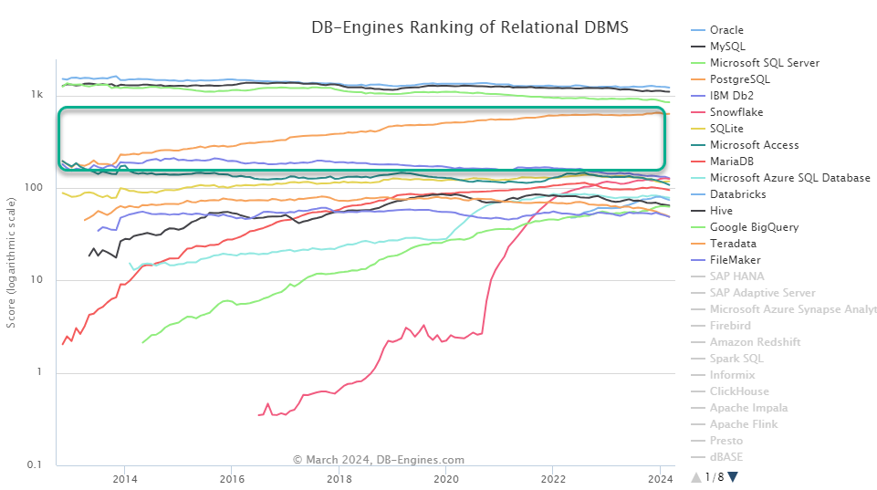
RDBMS Trend
Notes:
Officially known as PostgreSQL, as of 2014, postgres was the 4th leading database, steadily rising to meet SQL Server’s popularity. 27% of companies are using Oracle and Postgres together. Those moving to Postgres have realized up to 69% savings in their data costs (measuring over a 3 year time period from adoption)
https://scalegrid.io/blog/postgresql-vs-oracle-difference-in-costs-ease-of-use-functionality

Slide 6
Postgres Features
ANSI SQL:1999, and partial SQL:2003 and SQL:2008
Scalable & Highly Available (sharding, partitioning, streaming & logical replication)
ACID, Isolation levels, Transactions (DML + DDL), Integrity constraints
Securable (SSL, Encryption, RBAC: user-level, table-level, and row-level security)
Tables, views, materialized views, indexes, stored functions/procs, sequences
  IDENTITY columns, Generated columns
  Integrity constraints
  Table inheritance (super/sub-typing)
  Triggers, including INSTEAD-OF and updateable views
  Temporary tables and temporary views
Geospatial (quite good, only surpassed by ESRI)
Full-text search
JSON storage and operations
3GL routines in 18 languages, esp. pl/pgsql, tcl, java, python, ruby, javascript
TOAST (columns up to 1GB)
Windowing Functions
Rich aggregate, range and array functions
International character sets and multibyte character encodings
Robust and free support from online community. Plenty of paid options too.
Notes:
Complete documentation: https://www.postgresql.org/docs/16/index.html (v16 is a 3,141-page PDF)
See https://www.postgresql.org/about/featurematrix/ for history of when each feature was introduced.
Full SQL supported: https://www.postgresql.org/docs/current/sql-commands.html
TOAST (The Oversized-Attribute Storage Technique) automatically stores values larger than a single database page into a secondary storage area per table. The TOAST technique allows for data columns up to 1 GB in size.

Slide 7
Oracle and Postgres Architecture
Oracle | Postgres
Database Server = Instance + Database | Database Host = 1:N instances
Instance = BG processes + SGA + PGA | Instance = process serving 1:N databases
BG processes include: DBW#, LGWR, CKPT, SMON, PMON, RECO, ARC#, MMON, MMNL, RVWR | Pg processes include: Master, Writer, Stats collector, User sessions
Database = datafiles, control files, redo log files, archive log files, & parameter file | Database = subfolder under PGDATA/base Cluster-wide files are shared between databases, including tablespaces, accounts and roles
Instances share only the listener | Collection of databases share common file system location (aka PGDATA or “data directory”) and processes. This is known as a PG cluster.
Notes:
I prefer data engineering to database administration. So I’m not as well versed in database server software architecture.
I feel like this slide could further refinement, but I hope it still helps a little if this is where you like to swim.
Master process - launches the other processes, background and session processes.
Writer process - background process that coordinates database writes, log writes and checkpoints.
Stats collector process - background process collecting information about server activity
The server processes communicate with each other using semaphores and shared memory to ensure data integrity throughout concurrent data access
The Oracle files mentioned here are stored on a local file system, NFS files or SAN Devices. In the latter case Oracle uses ASM (Automatic Storage Management) to address data.
See https://www.2ndquadrant.com/en/blog/oracle-to-postgresql-basic-architecture/ for more
The following are some of the cluster configuration files:
postgresql.conf - Parameter or main server configuration file.
pg_hba.conf - Client authentication configuration file.
pg_ident.conf - Map from OS account to PostgreSQL account file.
The cluster subdirectories:
base - Subdirectorycontaining per-database subdirectories
global - Subdirectory containing cluster-wide tables
pg_auth - Authorization file containing user and role definitions.
pg_control - Control file.
pg_database - Information of databases within the cluster.
pg_clog - Subdirectory containing transaction commit status data
pg_multixact - Subdirectory containing multitransaction status data (used for shared row locks)
pg_subtrans - Subdirectory containing subtransaction status data
pg_tblspc - Subdirectory containing symbolic links to tablespaces
pg_twophase - Subdirectory containing state files for prepared transactions
pg_xlog - Subdirectory containing WAL (Write Ahead Log) files

Slide 8
Oracle and Postgres Architecture
Oracle | Postgres
CDB | postmaster
PDB | database within the cluster
Data blocks, extents, segments, tablespaces | Blocks, pages, files, tablespaces*
*tablespaces are just symbolic links to files
Notes:
The postmaster serves requests for database connections in the cluster. For each client connection it spawns a process named “postgres”, which handles the user session from there on out.
An individual PDB is like a database within the PG cluster.
As far as storage architecture is concerned you can see they are somewhat similar: starting with the smallest component of a block, then extents -> segments, and finally tablespaces. PG is a little less refined, storing data in blocks, contained in pages, contained in files, then tablespaces in name only.

Slide 9
Postgres Architecture
Sometimes the mental translation of similar terms is really rocky, especially when a term has multiple meanings. For example:
  Cluster = an ordered (clustered) index
  Cluster = a collection of databases
  Cluster = the act of re-organizing a table by re-ordering it
  Cluster = a collection of services participating in replication
Notes:
That was my current best effort putting the components of the two databases side-by-side. But even within Postgres a seemingly simple term can be hard to parse and have multiple meanings, like “cluster”
https://wiki.postgresql.org/wiki/PostgreSQL_for_Oracle_DBAs (article on major processes)

Slide 10
Postgres Positives
Open Source
Extensible
Partitioning included (range, list, hash)
Spatial included
Create metadata comment for most database objects
  Oracle 23c adds annotations, but is still limited to data objects, indexes, & domains
Can GROUP BY and ORDER BY column alias OR position!!*
IF EXISTS / IF NOT EXISTS*
No need for FROM DUAL when getting SYSDATE and other literals/functions*
CTEs are more capable
Multi-row VALUES lists*
Rich set of index types and custom indexing-frameworks
Direct joins* in UPDATE and DELETE
generate_series() to create large test datasets
Rich system admin and information functions
Rules and query re-writing
*now implemented in Oracle 23c
Notes:
As I gradually came to know the bright spots and dark corners in Postgres, I kept a list of things that I was impressed by, that I wished Oracle could do.
This slide is the primary reason I wanted to give this presentation, to let you know there are actually some really nice features awaiting you.
But as I dug into Oracle, which has advanced at least three versions since I last used it, I found that someone at Oracle must have been keeping a similar list. Many of the features I wished Oracle had, are now found in Oracle 23c, denoted by a light blue asterisk.

Slide 11
Postgres Negatives
MVCC architecture, dead tuples, vacuuming and its ilk
Lack of incremental materialized view refresh*
No built-in data masking or sub-setting
Not as mature in partitioning features and indexing
No hints** to influence CBO. Far less control and observability over stats and planner
Security and regulatory compliance not nearly as full and robust as Oracle’s
No synonyms
No internal job framework
PL/SQL: Lack of autonomous transactions, packages
No virtual columns or invisible indexes
Far less mature data dictionary and dynamic views of internals
Sharding is still a DIY affair, although it can be done using FDW
Only automatic parallel query. Less parallel and bulk operation helps
xid freeze/overwrite
Failover is a fairly manual process
*pg_ivm handles this
** pg_hint_plan extension
Notes:
Now as far as the dark spots, here is where I feel Postgres falls short, compared to Oracle
**There is the pg_hint_plan extension, but I haven’t yet seen it work
Dbms_transaction.local_transaction_id = xid

Slide 12
Postgres Extensions
PostGIS - geospatial
citext - case insensitive text datatype
pg_repack - online table re-organization
pgcrypto - encryption
pgbench - benchmarking
pg_stat_statements - essential, tracks distinct query stats over time
dblink - connect to other PG databases from within a session (postgres_fdw is better)
hstore - key-value datatype and functions
ltree - querying data stored in a hierarchical tree-like structure
pg_trgm - similarity search/match
tcn - notify listeners of changes to table content
pg_partman - partition creation and maintenance
So many more… (if you can dream it, someone has probably already extended it)
  See the official “contrib” modules included with Postgres, but not part of the core
  See this list of 1000+ extension repos on GitHub (YMMV)
Notes:
Here are just a couple handfuls of the most popular Postgres extensions. There are over a thousand.
Some extensions are mixed case, most are lowercase. Some use underscores. Some don’t. Some pg_* utilities are included with the postgres core, some are distributed as contrib modules, but have to be enabled. Some are 3rd party, but many of these names look just like core and contrib utilities!

Slide 13
Concepts/Miscellaneous
Category | Oracle | Postgres
Cost | Proprietary. Can be pricey. Advanced options cost extra. | Open source. Can be free, but fairly cheap on AWS, GCP or Azure. Advanced options often included.
Isolation Levels | Read Committed, Serializable, Read-only | Read Committed*, Serializable, Repeatable Read
Locks | Table, Row, User-defined, Lock-free Reservations (23c) | Table, Row, Page, Advisory
External Data | EXTERNAL tables, DATABASE LINK | Foreign Data (Wrapper, Table, Schema)
* Read uncommitted behaves just like read committed

Slide 14
Concepts/Miscellaneous
Category | Oracle | Postgres
Data Dictionary System Metadata | x$ tables, v_$tables; all*, user*, dba*, and v$ views | pg_catalog (lower level catalog tables and views) Monitoring views information_schema (views)
Full Text Search | Oracle Text, DBMS_SEARCH (23c) | Full text search data types, functions and engine
Graph | Native graph data structures & search | apache/age
Security | In-database or in-export data masking and data sub-setting, VPD, TDE, OAS, Government-grade authn, + | pgcrypto, six levels of encryption, row-level security, invoker rights on views, LDAP/RADIUS authn, +
Notes:
Oracle was already the premier database with version 11g. With 12c to 23c they introduced so many more features and options, that it is unlikely anyone will ever catch up. TimesTen in-memory Db. Automatic Transaction Rollback. Blockchain tables, built-in connection management, Fast Ingest, Kafka APIs, MongoDB APIs, and so, so much more. Some of these features are available in certain, pay-for forks of Postgres, like EnterpriseDB, Citus and CyberTec, but none of them approach Oracle in completeness. Of course in Oracle, many of these excellent new features are not free, so there’s that.

Slide 15
Backup and Recovery
Oracle | Postgres
Full and Incremental backups expdp/impdp RMAN Flashback (table, database, etc.) Point-in-Time Recovery (PITR) | Pg_basebackup pg_dump/pg_dumpall/pg_restore DIY file-system backups Time-delayed Standby* Continuous WAL Archiving and PITR
Data Guard | Hot Standby, Warm Standby
Notes:
Using a delayed standby in Postgres roughly mimics FLASHBACK DATABASE. See https://www.percona.com/blog/faster-point-in-time-recovery-pitr-postgresql-using-delayed-standby/

Slide 16
REDO, Archiving, UNDO, Logging
Oracle | Postgres
Journaling/Log Writer REDO | WAL (Write-ahead Logging) + past rows (dead tuples) kept in the table files
UNDO Segments | MVCC design means updated/deleted records are already there alongside the “live” rows (until they get vacuumed*)
Alert Log | Server Log
Notes:
Changes to data files (tables and indexes) are written only after those changes have been logged (log records flushed to permanent storage). WAL files are kept in pg_xlog subdirectory of the cluster’s PGDATA area. By default WAL is divided into 16MB segment files. They get recycled.
To-Do: Research how to undo DML whose dead tuples have been cleaned up and re-used.

Slide 17
Replication and HA
Oracle | Postgres
Stand-by Database Oracle Data Guard Oracle Streams, Oracle GoldenGate RAC | Streaming and logical replication to log-shipping standby or hot standby
Notes:
Oracle Data Guard facilitates synchronous and asynchronous replication for disaster recovery, while RAC allows load balancing and fault tolerance through the distribution of data across multiple nodes.
https://www.postgresql.org/docs/current/high-availability.html

Slide 18
Migration
Oracle | Postgres
SQL*Loader Data Pump | COPY pg_dump/pg_restore pgloader
 | Ora2pg oracle_fdw orafce AWS DMS, Schema Conversion Tool
Notes:
http://ora2pg.darold.net/ ora2pg can connect to Oracle and write DDL/migration scripts

Slide 19
Commands/Utilities
Oracle | Postgres
dbca | initdb/createdb
srvctl (RAC control) | pg_ctl (cluster and database control)
exp/imp; expdp/impdp | pg_dump/pg_restore
dbms_lock.sleep/dbms_session.sleep | pg_sleep* functions
INSERT /*+APPEND*/ FROM ExternalTable | COPY (from file to table), FDW, Foreign Tables

Slide 20
SQL
Oracle | Postgres
START WITH…CONNECT BY… | WITH RECURSIVE
NVL | COALESCE
MINUS | EXCEPT
– | IS DISTINCT FROM
– | OVERLAPS

Slide 21
Datatypes - Character-based
Oracle | Postgres
[N]VARCHAR2(n) (up to 4k/32k) | VARCHAR(n) (up to 1GB) CHARACTER VARYING(n) (up to 1GB)
[N]CHAR(n) (up to 2k) | CHAR(n), aka CHARACTER(n) or BPCHAR(n)
[N]CLOB (up to 4GB*DB block size) | TEXT (up to 1GB)
– | BPCHAR (up to 1GB)
Notes:
TEXT is unlimited (to 1GB). BPCHAR is unlimited, but instead of blank-padded to `n` (since there is no `n`), the docs say it is blank-trimmed.
“n” is bytes in Oracle, but characters in Postgres
NCHAR, NCLOB, NVARCHAR have different max sizes depending on character set being used. Postgres datatypes natively support ANSI or Unicode characters

Slide 22
Datatypes - Numeric
Oracle | Postgres
NUMBER(s,p) | NUMERIC(s,p)
NUMBER(4) | SMALLINT, aka INT2
NUMBER(9) or INTEGER | INTEGER, aka INT or INT4
NUMBER(18) | BIGINT, aka INT8
NUMBER, NUMBER(19+) | NUMERIC(n), DECIMAL(n)
FLOAT(p), BINARY_FLOAT, BINARY_DOUBLE, REAL, DOUBLE PRECISION | REAL (6 decimal digits) DOUBLE PRECISION (16 decimal digits)
Notes:
There is also REAL and DOUBLE PRECISION, which are floating point types, or “inexact, variable-precision numeric types”

Slide 23
Datatypes - Date and Time
Oracle | Postgres
– | DATE
DATE | TIMESTAMP
– | TIME [WITH TIME ZONE]
TIMESTAMP [WITH [LOCAL] TIME ZONE] | TIMESTAMP [WITH TIME ZONE]
INTERVAL YEAR TO MONTH INTERVAL DAY TO SECOND | INTERVAL
Notes:
This is simplified a little. The time and timestamp datatypes have an optional parameter to specify precision up to 6 digits.

Slide 24
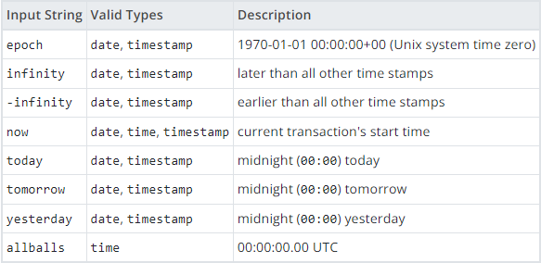
Datatypes - Date and Time
Special postgres date/time values

Slide 25
Datatypes - Other
Oracle | Postgres
BOOLEAN (as of 23c) | BOOLEAN
BLOB (up to 4GB*Block Size), RAW(n) (up to 2k/32k), BFILE (up to 2⁶⁴-1 byte) | BYTEA (1GB limit) or Large object
– | MONEY
SYS_GUID() (RAW 16 bytes) - not RFC 4122 compliant | UUID
JSON (up to 32MB) (as of 21c) | JSON / JSONB
SDO_GEOMETRY, SDO_TOPO_GEOMETRY, SDO_GEORASTER | Geometric: , GEOMETRY, POINT, LINE, LSEG, BOX, PATH, PATH, POLYGON, CIRCLE
URI types | Network: INET, CIDR, MACADDR, MACADDR8
 | BIT(n), BIT VARYING(n)
XMLType | XML
Notes:
boolean comparison expressions accept these string representations for the “true” state: true, yes, on, 1
and these representations for the “false” state: false, no, off, 0
Use of money datatype isn’t recommended.
inet type holds an IPv4 or IPv6 host address, and optionally its subnet, all in one field.
inet accepts values with nonzero bits to the right of the netmask, whereas cidr does not

Slide 26
Datatypes - Other
Oracle | Postgres
NESTED TABLE or VARRAY | Arrays: Postgres allows columns to be arrays of any built-in datatype, and even multi-dimensional, e.g. INTEGER[] or VARCHAR[][]
UDT (CREATE TYPE… TYPE BODY…) | UDT (CREATE TYPE…)
– | A whole host of special “pseudo-types” for use in functions, not columns
– | Range: int4range, int8range, numrange, daterange, tsrange, tstzrange
DOMAIN (CREATE DOMAIN…) (as of 23c) | DOMAIN (CREATE DOMAIN…)
ROWID, UROWID | –
– | tsvector, tsquery (full text search datatypes)
Notes:
boolean comparison expressions accept these string representations for the “true” state: true, yes, on, 1
and these representations for the “false” state: false, no, off, 0
Use of money datatype isn’t recommended.
inet type holds an IPv4 or IPv6 host address, and optionally its subnet, all in one field.
inet accepts values with nonzero bits to the right of the netmask, whereas cidr does not

Slide 27
Tools
Category | Oracle | Postgres
Automation Command Line | SQL*Plus SQLcl | psql
Developer IDE DBA tasks | SQL Developer PL/SQL Developer TOAD | DBeaver DataGrip pgAdmin
Data Modeling | SQL Developer Data Modeler ($ for erwin, ER/Studio, DbSchema) | SQL Developer Data Modeler ($ for erwin, ER/Studio, DbSchema, pgModeler)

Slide 28
Subtle Differences
As of Sep 2019 (PostgreSQL v 11/12)
Category | Oracle | Postgres
Unique Key | The uniqueness is enforced across whatever combination of columns is populated. The only possibility for identical rows is where all columns in the key are NULL. | The uniqueness is enforced across all columns, including those containing NULL values. Because an equality operation against two NULL values does not match, a NULL column value will result in non-distinct rows succeeding in an insert statement.
Default Values | When adding a new column with a default value, the new default is immediately written to all rows. | When adding a new column with default values, the new default is returned the next time the row is accessed. For defaults that will vary (such as timestamps), this will result in inconsistent values based on the first access. Manually updating the values before applying the default can fix this.

Slide 29
Subtle Differences
Category | Oracle | Postgres
ALTER Column | ALTER {table} MODIFY {column} | ALTER {table} ALTER {column}
ALTER Data Type | A change to the data type definition will be disallowed unless 1. the column is empty OR 2. the length or scale parameters are increasing | A change to the data type definition will be allowed in many cases by default, using the implicit conversion. Additional conversions can be allowed as well, by providing the conversion explicitly in a USING clause.
Terminology | User = Schema = Account | User = Role* = Account *Role that allows login is a user. Role that disallows login in a group.

Slide 30
Subtle Differences
Category | Oracle | Postgres
Row & Column Security | Row level security only. Highly customizable through the functions behind VPD. Requires maintaining code to enforce access control. | Row and column level security are administered through the standard GRANT syntax
DML within CTE | Not available | Allowed, usually to chain multiple operations into a single statement.
IS DISTINCT FROM | No built-in SQL syntax for this. Approximated substituting defaults, e.g. NVL(col1,’~’) != NVL(col2,’~’) | Available out of the box

Slide 31
Subtle Differences
Category | Oracle | Postgres
Transactions | EXCEPTION does not automatically rollback the transaction. | EXCEPTION executes in atomic sub-transaction, rolling back everything to the BEGIN in the enclosing block
Transactions | Can control transactions with explicit SAVEPOINT, COMMIT & ROLLBACK | Cannot control transactions from within pl/pgsql functions.
Timestamp Functions | SYSDATE and SYSTIMESTAMP are current time | Only clock_timestamp() returns the value of right now. Others are tied to start of session, statement or transaction.
Conversion Functions | TO_DATE returns DATE (which includes time) | TO_DATE returns DATE (NOT time)
Notes:
So now(), current_timestamp() aren’t actually now or current if your stored proc began any more than a second ago.

Slide 32
Subtle Differences
Category | Oracle | Postgres
 | Empty string ‘’ = NULL ‘’ || NULL = ‘’ | Empty string ‘’ != NULL ‘’ || NULL = NULL
Sequences | sequence_name.NEXTVAL | nextval(‘sequence_name’)
SUBSTR | SUBSTR(‘ABC’, -1) => ‘C’ | SUBSTR(‘ABC’,-1) => ‘ABC’
Notes:
So now(), current_timestamp() aren’t actually now or current if your stored proc began any more than a second ago.

Slide 33
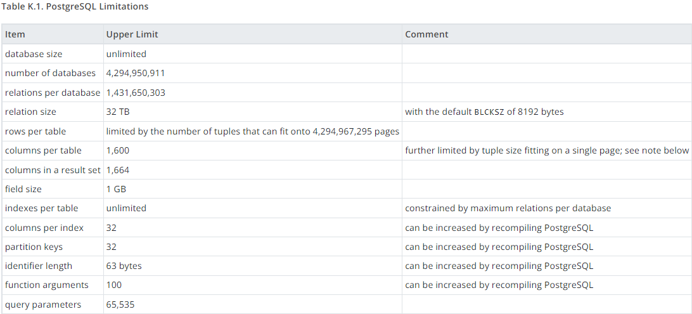
Postgres Limits

Slide 34
Kicking the Tires
Let’s Go…

